Slide 1


Slide 2

Details of Outing
Day and Date
(fill in)
Time
(fill in)
Venue
Bird Paradise (Penguin Cove)
20 Mandai Lake Rd, Singapore 729825
Attire
School Uniform for students
As it is a public place, school uniform is required for easy identification.
1

Slide 3
Overview
01
Outing Flow
Page 3
02
Making your way to
Bird Paradise
Page 4
03
Safety Information
Page 12
04
Q&A
Page 17
2

Slide 4

Outing Flow
Suggested plan:
12.50pm to 1.25pm | Briefing and Toileting at school
1.25pm to 2pm | Boarding of bus and travel to Bird Paradise
2pm to 2.15pm | Headcount and enter Bird Paradise
2.15pm to 3.15pm | Visit Penguin Cove
3.15pm to 3.45pm | Toileting and snack time
3.45pm to 4pm | Boarding of buses
4pm to 4.30pm | Back to school!
3

Slide 5

4

Slide 6
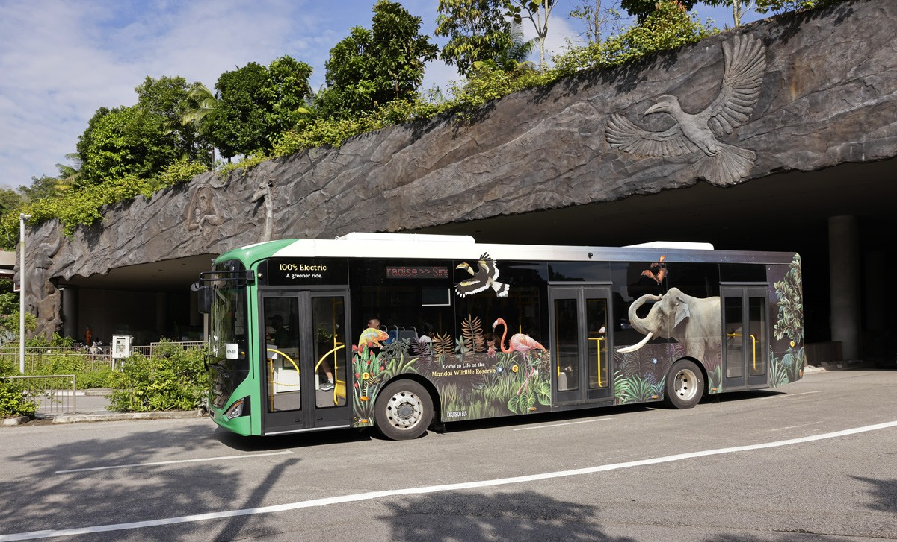
Making your way to Bird Paradise
(When arriving by personal transport or public transport)
Click below for:
Car
Bus (Khatib shuttle / 927 / 138)
Taxi
5

Slide 7


From Carpark
6

Slide 8


From drop-off point
7

Slide 9

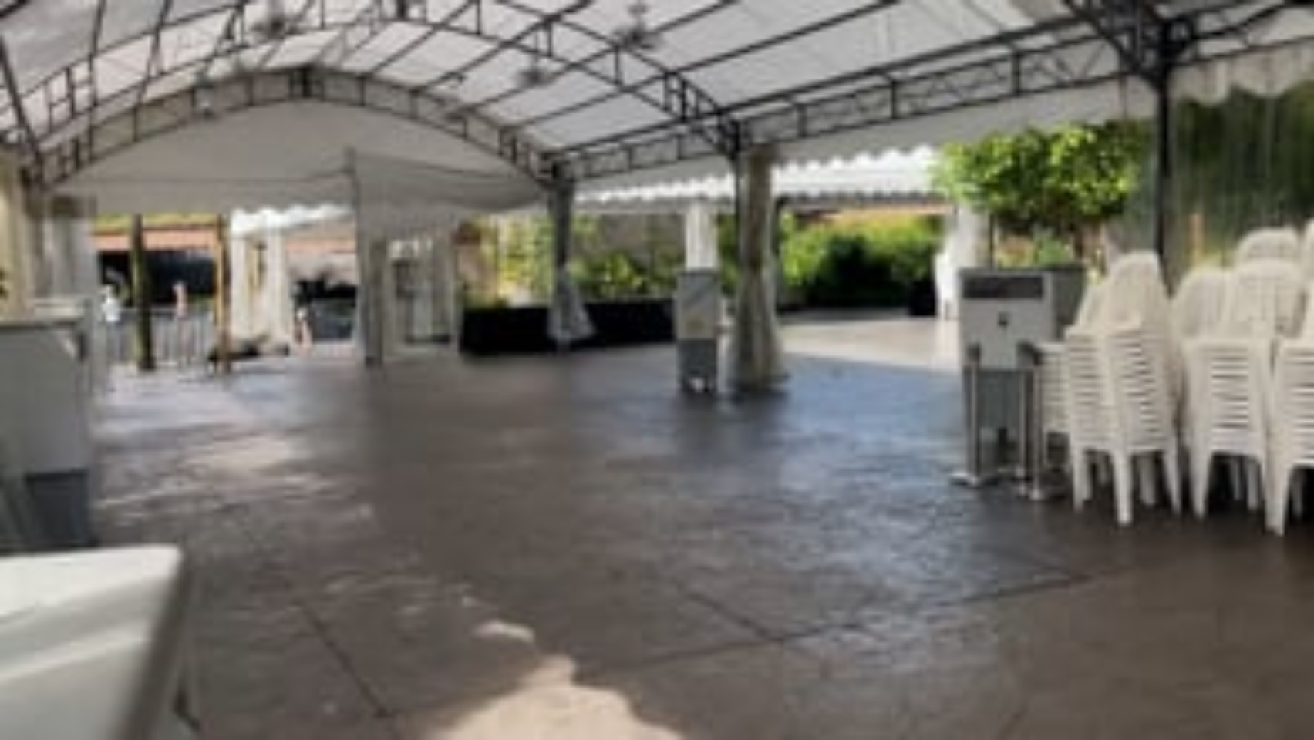
From bus stop
8

Slide 10
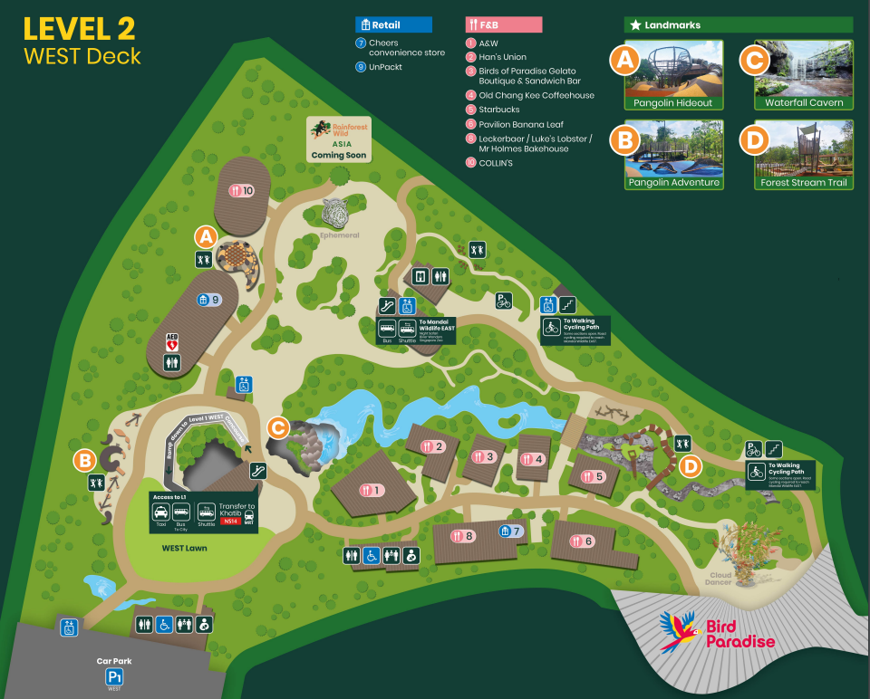

Mandai Wildlife West
(Click picture for a larger image)
9

Slide 11
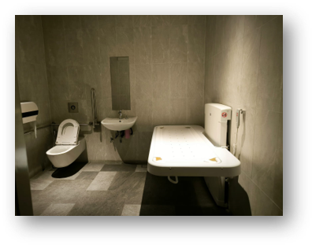
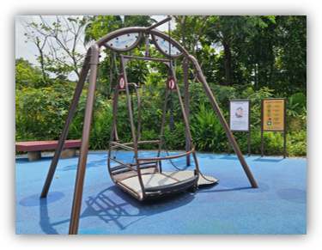
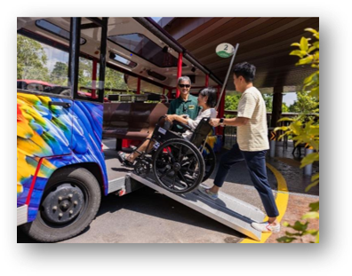
Inclusive features at Bird Paradise
Adult-sized change beds
(Waterfall Cavern at B1 & beside Bird Bakery cafe)
Wheelchair accessible
play equipment
(Pangolin playground at Mandai Wildlife West)
Ramps and
accessible paths
10

Slide 12

Meet at entrance of Bird Paradise
11

Slide 13

12

Slide 14
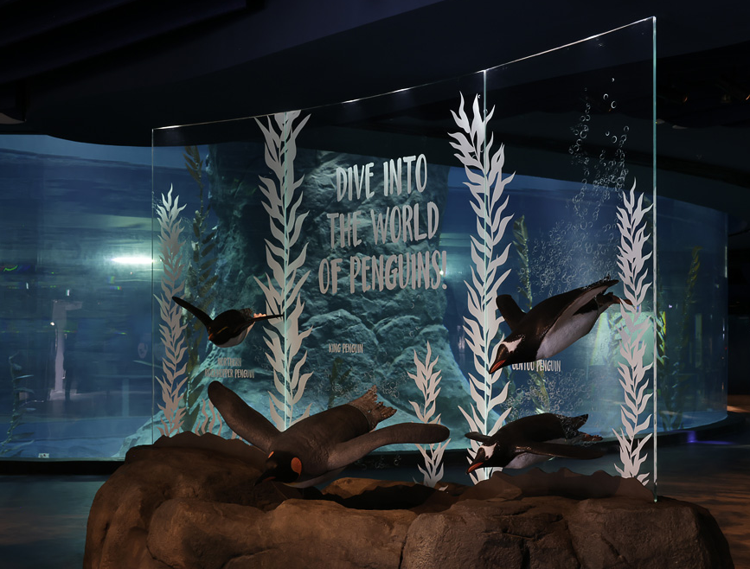


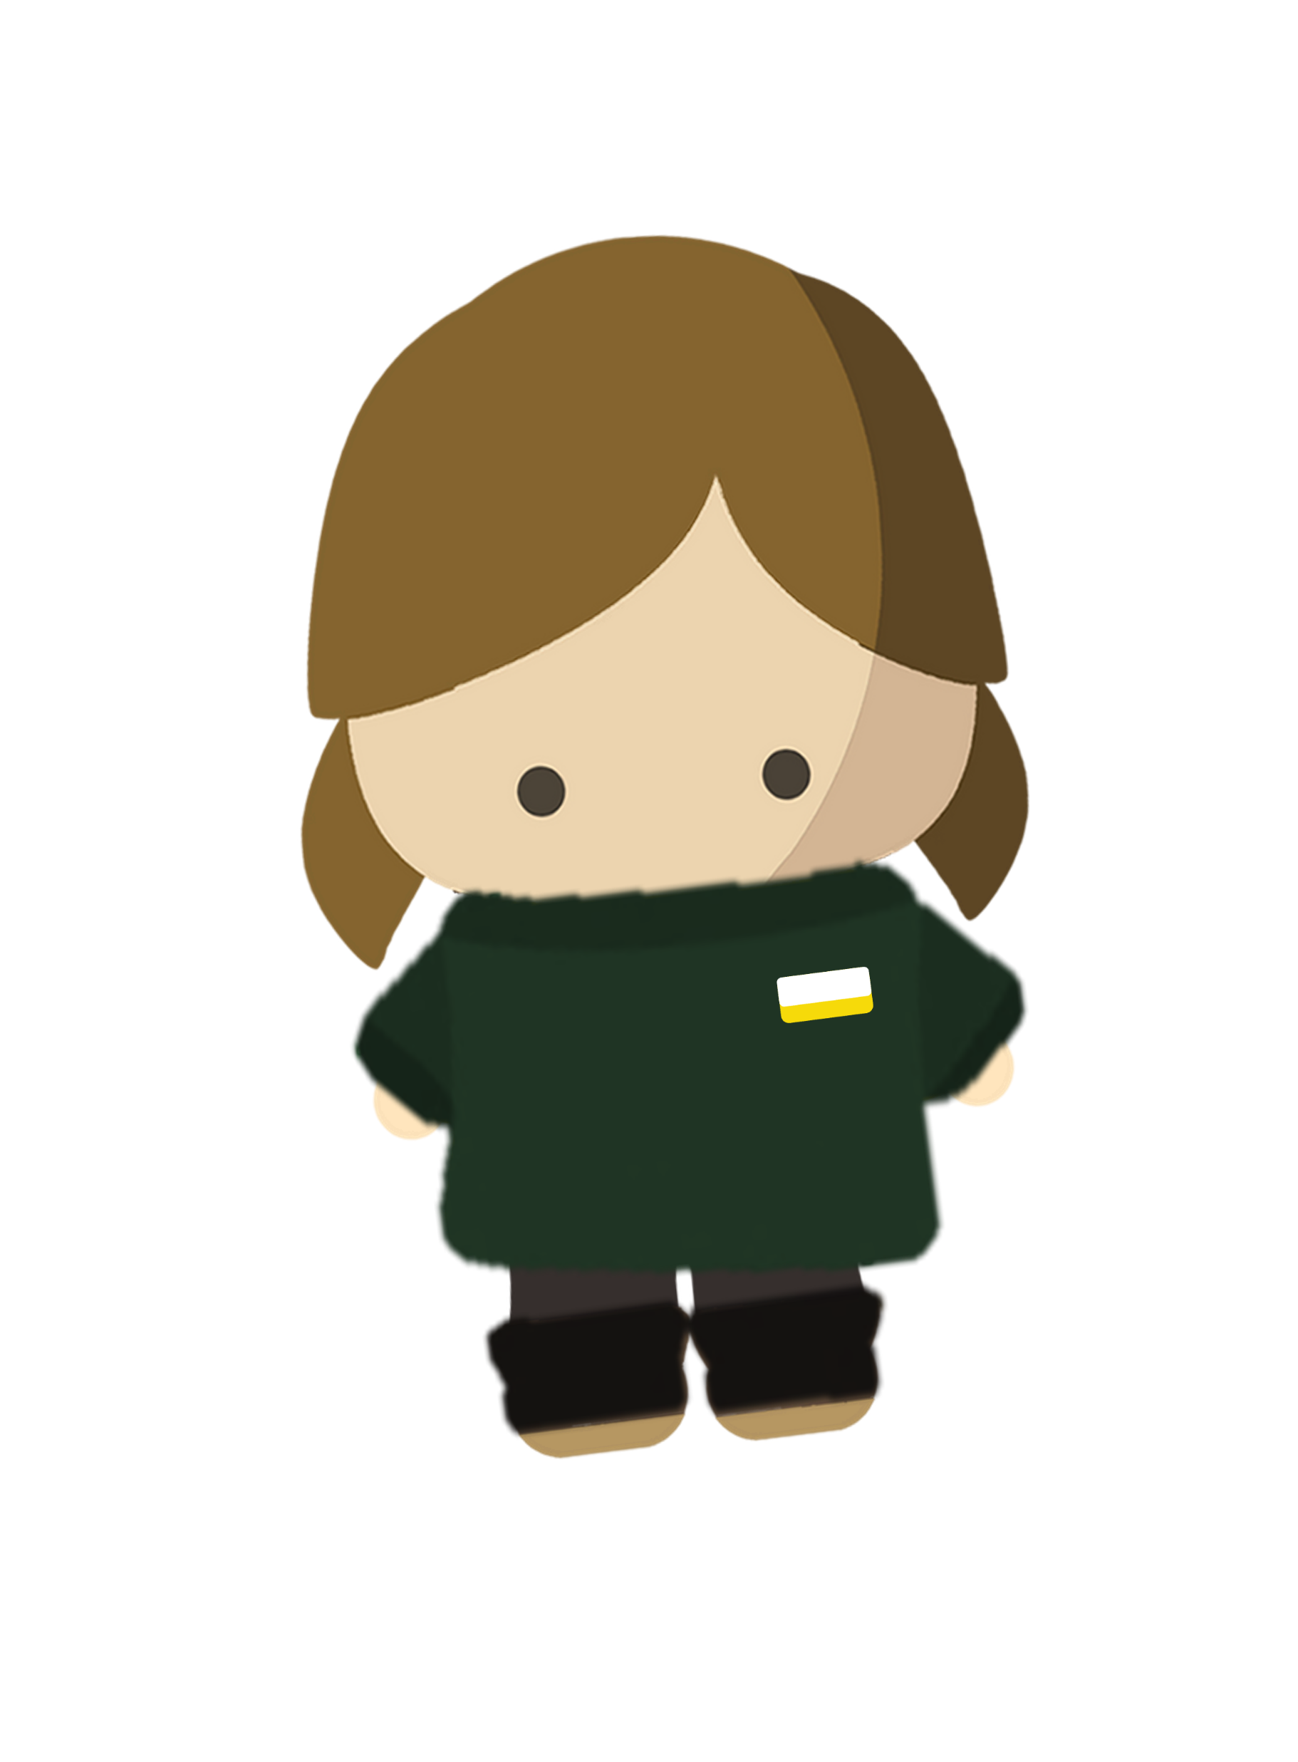
Take note…
May I know…
When we enter Penguin Cove, it will be cold and dark.
Please stay with your child at all times.
Ask for help if needed.
13

Slide 15


Take note…
Penguin Cove is cold, please bring a jacket if needed.
Photos are welcomed, but no flash photography please.
Adult-sized change beds are available. Ask for help and directions when needed.
14

Slide 16
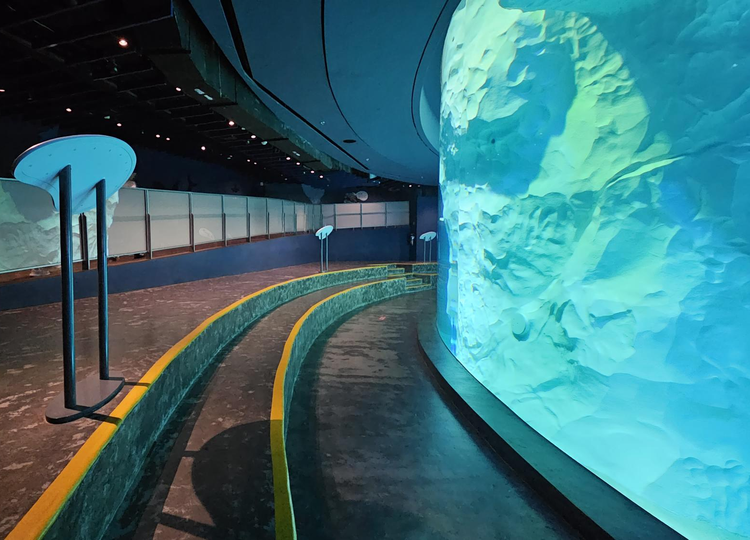
Calm areas at Penguin cove
Seating area at level 1
(you may consume snacks here)
15

Slide 17
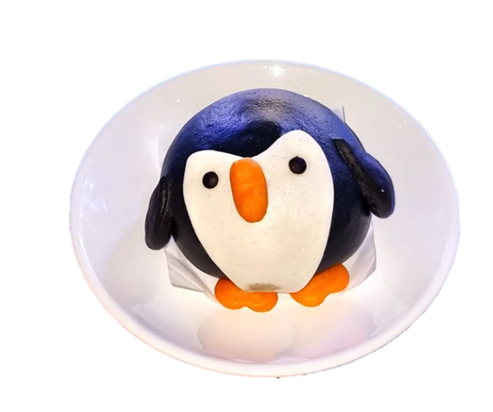
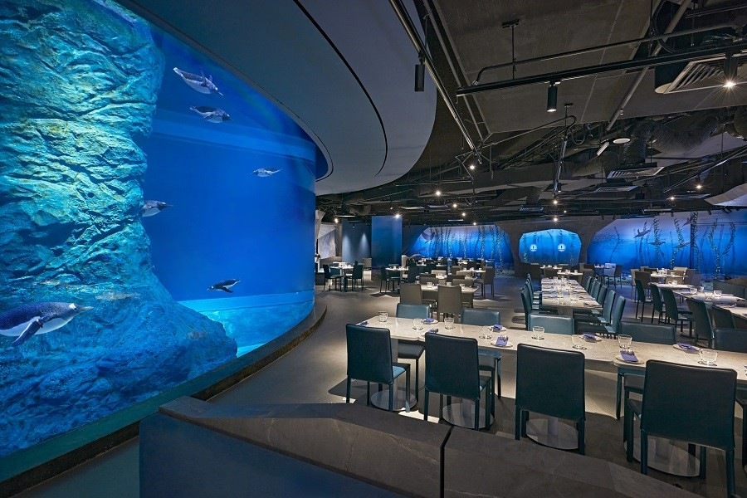
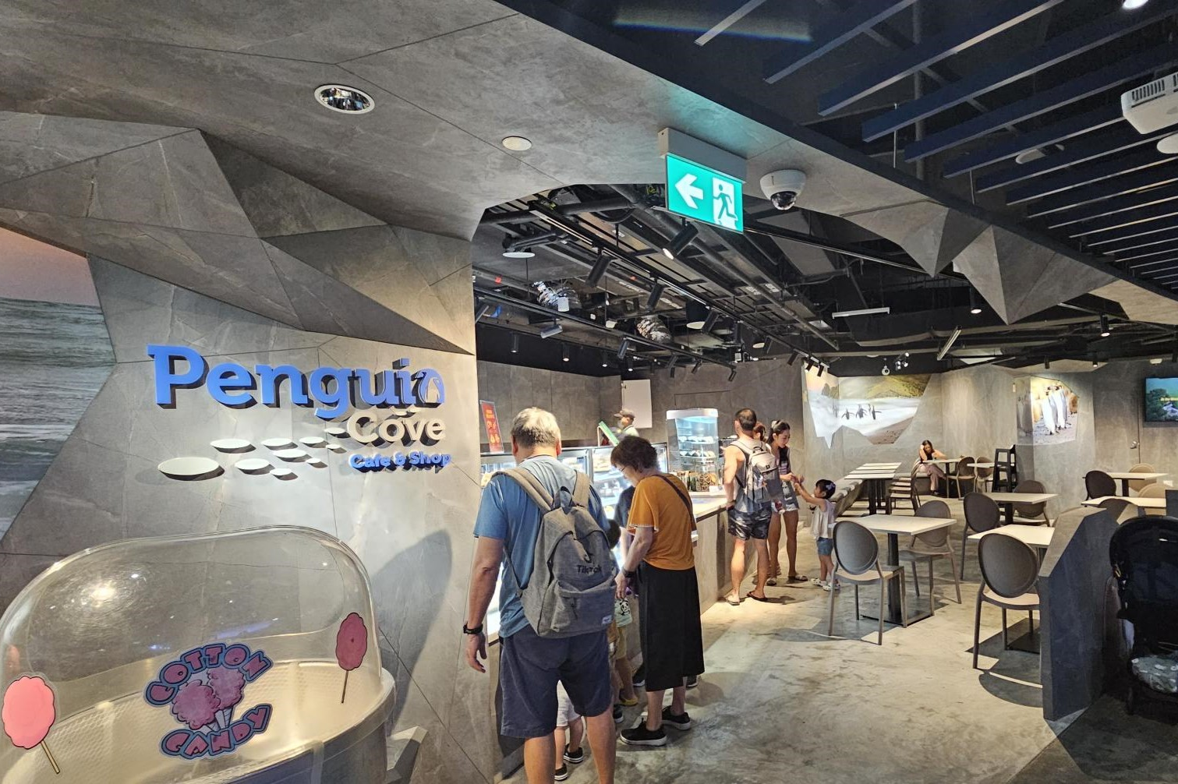
Food and Beverages options
Penguin Cove restaurant
Penguin Cove café and shop
16

Slide 18

17

Slide 19
Frequently Asked Questions
Can I be dismissed from Bird Paradise? | Yes, do inform your class teacher before leaving. Parents are required to sign the early dismissal form.
Can my family join for the outing? | Due to transport arrangements, only 1 adult is permitted per child. Your family members would need to purchase the tickets on their own and meet us directly at bird paradise.
What is the wet weather plan? | The entire outing is sheltered, inclusive of the pick-up and drop-off points.
Can I interact with the penguins? Can I bring a penguin home? | There will be no direct contact with the penguins. There are penguin themed snacks and toys available for purchase.
18

Slide 20


